Slide 1

AI-Based Communication Tool For High-Functioning Autistic Children
Farah Ossama – 1180456
Fatmah Issam – 1180606
Menna Hesham – 1180155
Menna Kamel – 1170354
Yumna Hamdy – 3190001

Slide 2
TABLE OF CONTENTS
01
Introduction
02
Problem definition
03
Objective
04
Market analysis
05
Technical Aspects
06
WorkFlow

Slide 3

01
INTRODUCTION
Autistic spectrum Disorder

Slide 4

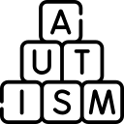

Autism Spectrum Levels
High- functioning Autism
Autism
Severe Autism

Slide 5
02
Problem Definition
Problem Statement

Slide 6
Obstacles
Awareness and knowledge
Assistance to autistic individuals
Communication skills
Blending in with society
Language Barriers

Slide 7
03
Objectives
Our Goals

Slide 8

SMART Goals
Therapeutic Games
Pseudo
Social Script
Model
Integration
Deployment
Final Goal
End-to-end Product

Slide 9
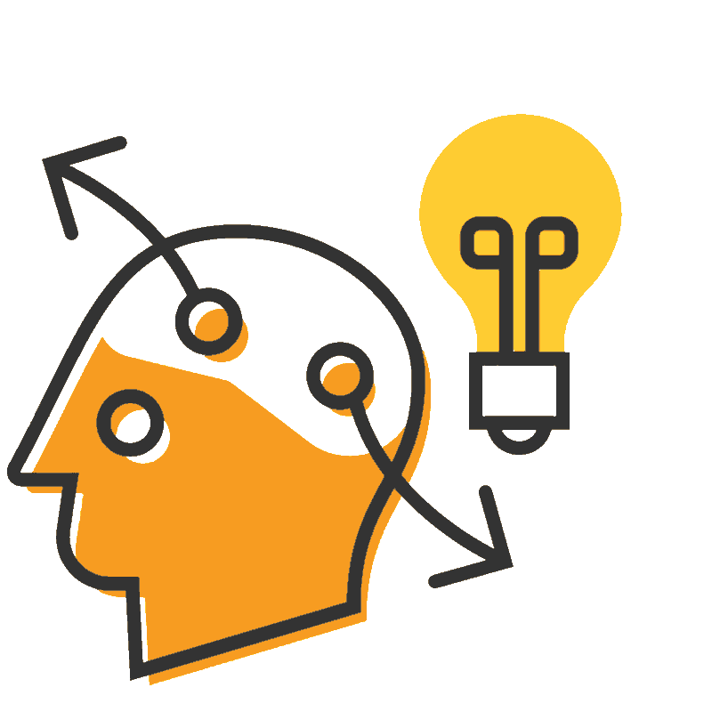

Objective

Slide 10
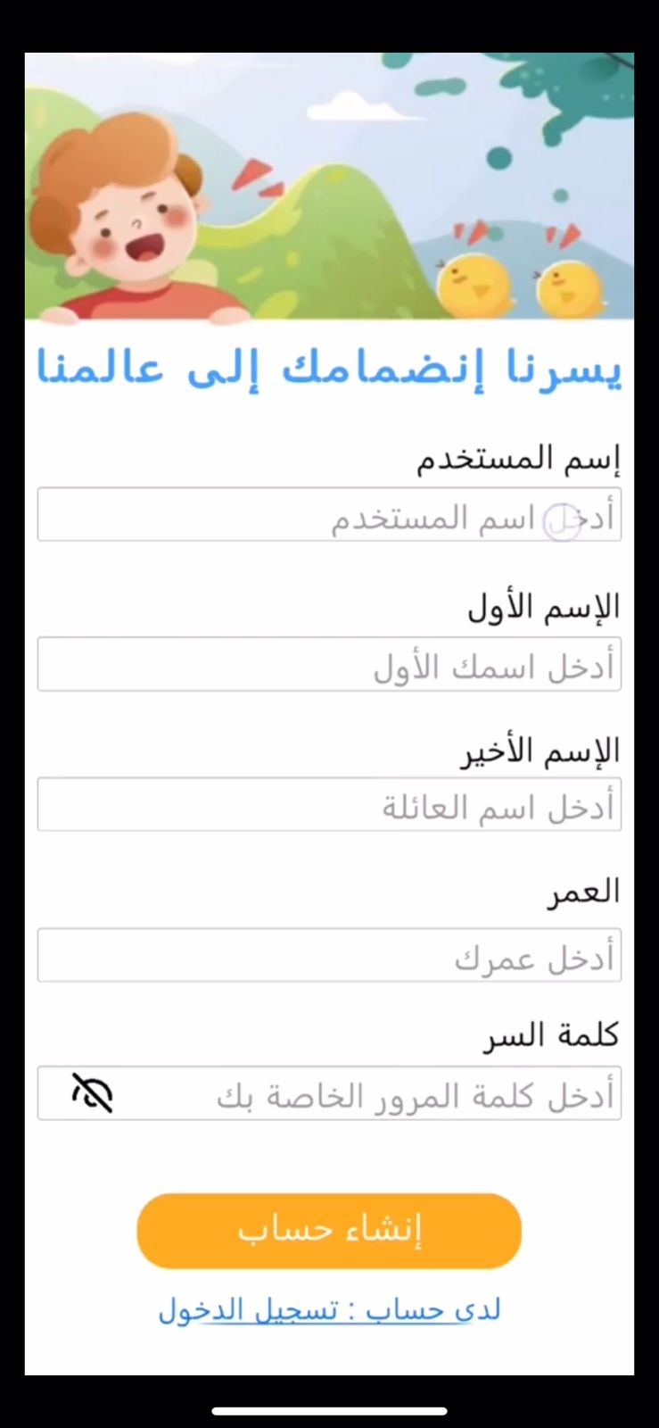


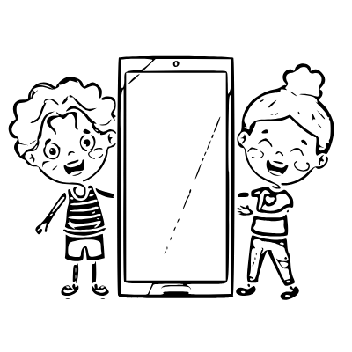
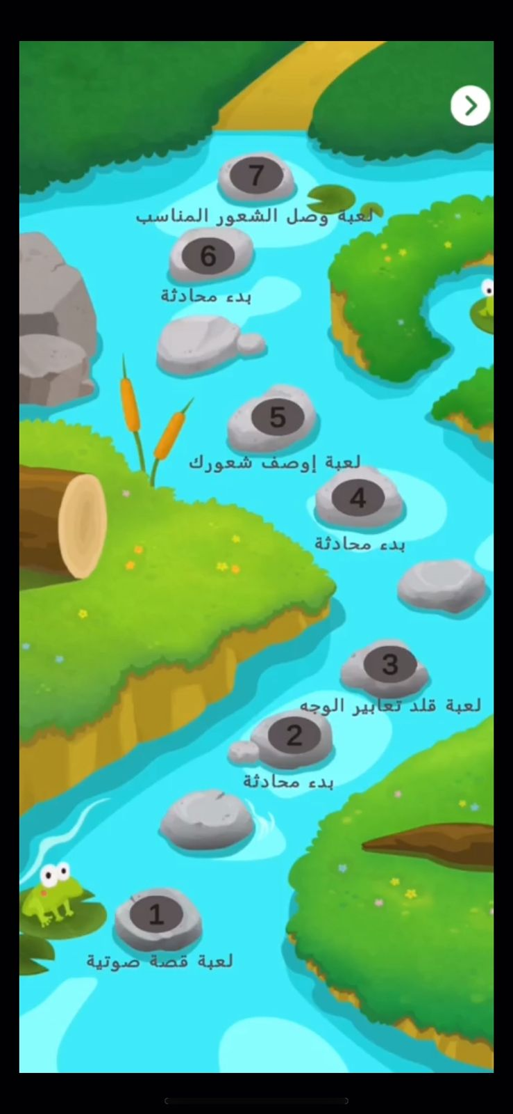
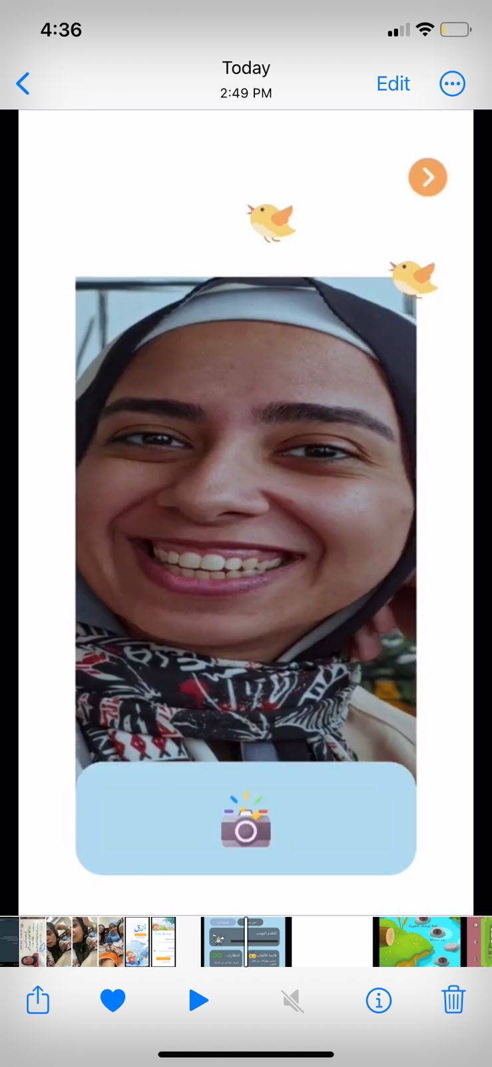
User Story
Sign Up
01
Start a Conversation
02
05
Login
Play Games
03
04
Detect Emotion

Slide 11
04
Market Analysis
Market size
Competitors
Target Market
SWOT Analysis

Slide 12
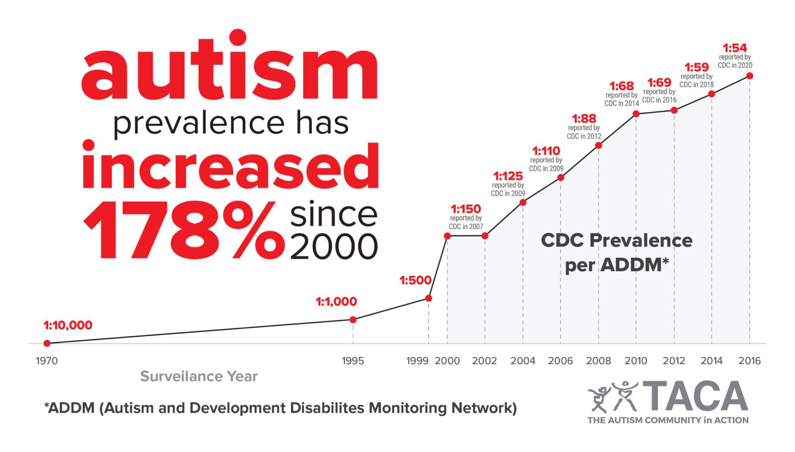
Autism Statistics
Autism prevalence has increased 178% since 2000.
Around 75 million people have autism spectrum disorder, that's 1% of the world’s population.
It is estimated that worldwide about 1 in 100 children has autism.
Notes:
Clarify the huge increase in autism rate worldwide

Slide 13
Autism Statistics
1 in 54 children
U.S.
1 in 88 children
1 in 160 children
Qatar
Egypt
The country with the highest autism rate
Notes:
NEW YORK (July 7, 2019) -- A team of researchers recently completed the first autism prevalence survey in Qatar, finding a prevalence rate of 1.14 percent, or 1 in 88 children.
Go in details to highlight the difference between few arabic applications offered for qatar which is the country has highest autism rate and a lot of applications offered for Us autistic individuals
There is a distinct lack of reliable numbers on diagnoses in the Middle East for autism and other related disorders, partially due to the lack of clinics and qualified medical personnel to work with them and diagnose them.

Slide 14
USD 1.34 billion in 2018
USD 2.2 billion by 2025
Growing at a CAGR of 7.8% between 2019 and 2025
global market for autism apps was valued
global market for autism apps expected to reach
According to a report by Research and Markets
Notes:
In terms of specific types of applications, there has been a growing market for autism-friendly apps in recent years. According to a report by Research and Markets, the global market for autism apps was valued at USD 1.34 billion in 2018 and is expected to reach USD 2.2 billion by 2025, growing at a CAGR of 7.8% between 2019 and 2025. This includes a wide range of apps, including educational apps, communication apps, and apps that help individuals on the autism spectrum with daily living skills.
CAGR: KayGar Compound annual growth rate

Slide 15

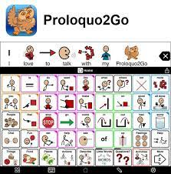

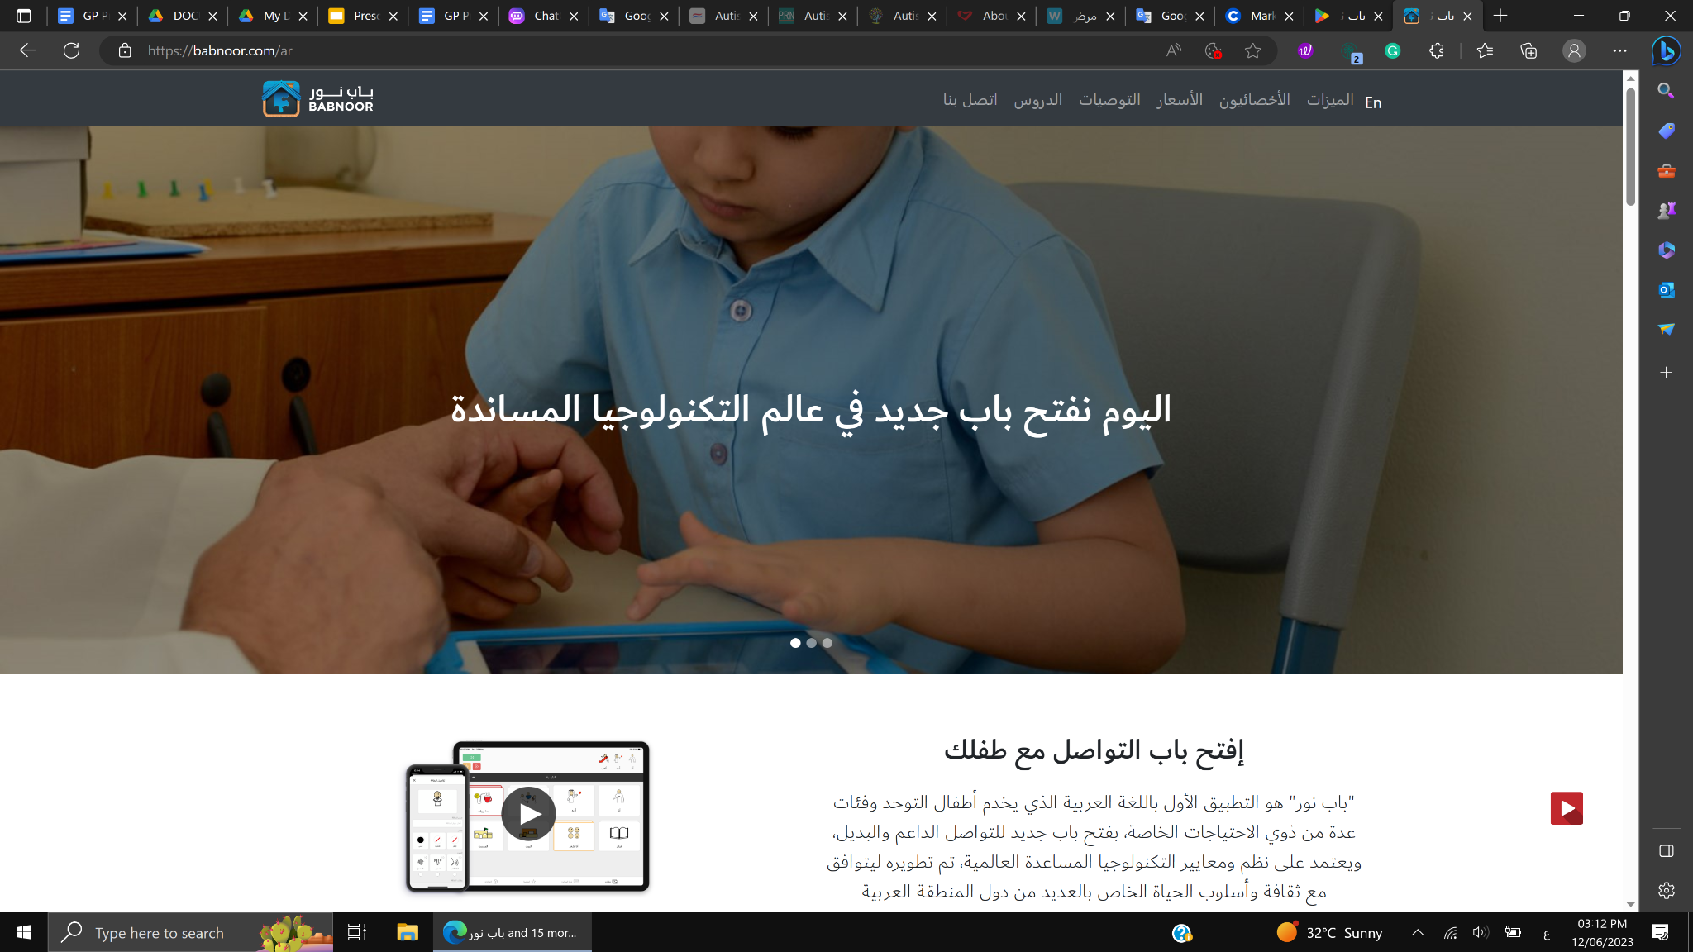
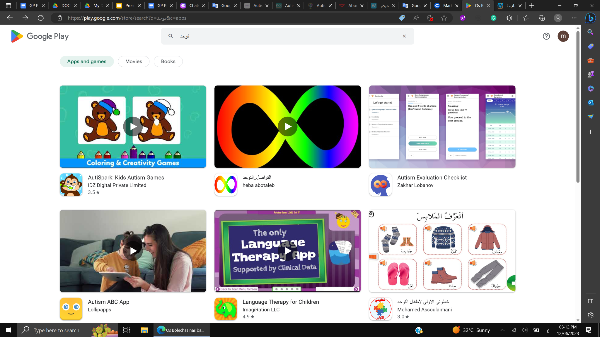

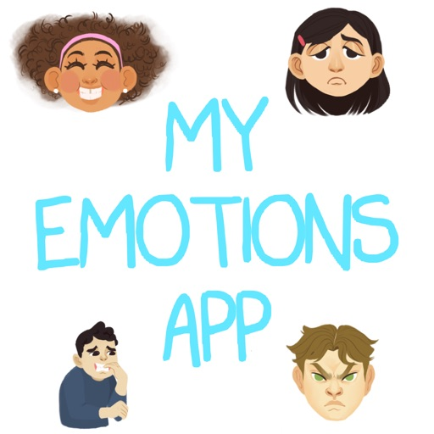

OUR Competitors
National
Alternatives
Global
For non verbal autistics children
For non verbal autistics children
Behavioral Therapy sessions
For verbal autistics children
Applications for Arabic-speaking autistics children
Our substitutes in the market
Applications for Autistics children
Notes:
Proloquo2Go: This is a popular iOS app that provides a voice for those who cannot speak. It includes text-to-speech voices, symbols, and customizable layouts to help children communicate.
TouchChat HD: This app is available for both iOS and Android devices and uses symbols and pictures to help children communicate. It also includes a range of vocabulary sets and the ability to customize the interface.
Avaz: This app is designed for children with speech difficulties and includes a picture-based vocabulary of over 15,000 words. It also includes text-to-speech and voice recording features.
Social Stories Creator & Library: This app allows parents, teachers, and therapists to create and share social stories with children. Social stories can help children with autism understand social situations and develop social skills.
My Emotions: This app is designed to help children with autism identify and understand their emotions. It includes a range of activities and games that can help children develop emotional regulation skills.
Otsimo: Otsimo is a mobile application that provides educational games and activities for children with autism. The app is designed to help children with autism improve their cognitive, language, and social skills through interactive games and exercises.

Slide 16




Target Audience
High function Autistic children between 6 -12
Parents and caregivers
Educators and therapists
Autism Treatment Centres

Slide 17
SWOT Analysis
Strength | Weaknesses
Opportunities | Threats
Arabic application for Verbal autistics children
Autistic child can use the application independently, without parents' or caregivers' guidance.
Autistic child can identify others' emotions and express his feelings better
Autistic-friendly interface
The application will never replace therapy sessions
Improve autistic individuals' social skills
Minimize therapy sessions for communication
Reducing the burden on caregivers
Raising awareness of autism in the Arab world
Difficulty to convince people to blend therapy sessions with the mobile application
The predicament of convincing doctors to promote the application.
Society's low awareness with autism.

Slide 18
05
Technical Aspects
System modules
System Requirements

Slide 19
System Modules
Facial Emotion Recognition
Mobile App
Game Development
Pseudo-social script

Slide 20
System Requirements
System must detect the emotions.
System must provide, on the mobile app, therapeutic games and a pseudo-social script.
System must unlock the pseudo-social script (PSS) after the completion of a game.
System must analyze if the user’s words match the given directions in the PSS.
The system must have all features in Arabic.
The system must be autistic-friendly.
The system’s response time during navigation must be less than 2 seconds.
Functional
NonFunctional

Slide 21
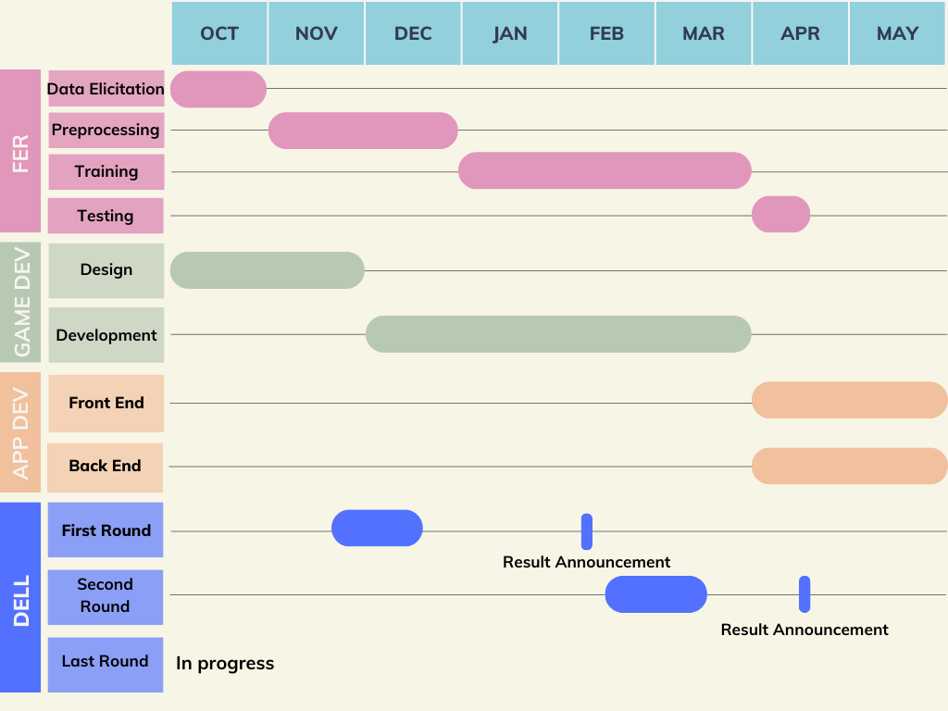
Gantt chart

Slide 22

Dell Competition
First
Round
Last
Round
Second Round
Project Abstract Submission
Final Report Submission
Interim design report submission
Top 27 in the region

Slide 23
06
Workflow
FER Timeline
Mobile Application Timeline

Slide 24






FER TIMELINE
Oct
Nov
Jan
Mar
Apr
Data Elicitation
Preprocessing
Training
Plan B: FerPlus
Face & Emotion Detection

Slide 25
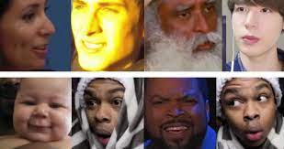

Data Elicitation
Learning & Researching
AffWild2 Dataset

Slide 26

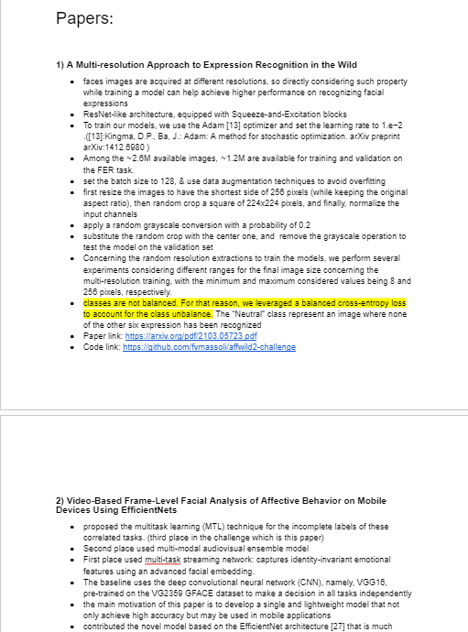

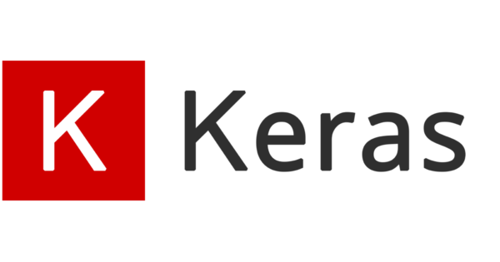




Learning & Researching
Facial Emotion Recognition
Deep Learning
Tools

Slide 27

AffWild2 Dataset
~2 million
7 Expressions
In-the-Wild images
Happy, Sad, Neutral, Angry, Disgust, Surprise, Fear
3 Tasks
Diverse
Annotations for expression, action units, and valence-arousal
Valuable resource for reseachers

Slide 28
FER TIMELINE
Oct
Nov
Jan
Mar
Apr
Data Elicitation
Preprocessing
Training
Plan B: FerPlus
Face & Emotion Detection

Slide 29

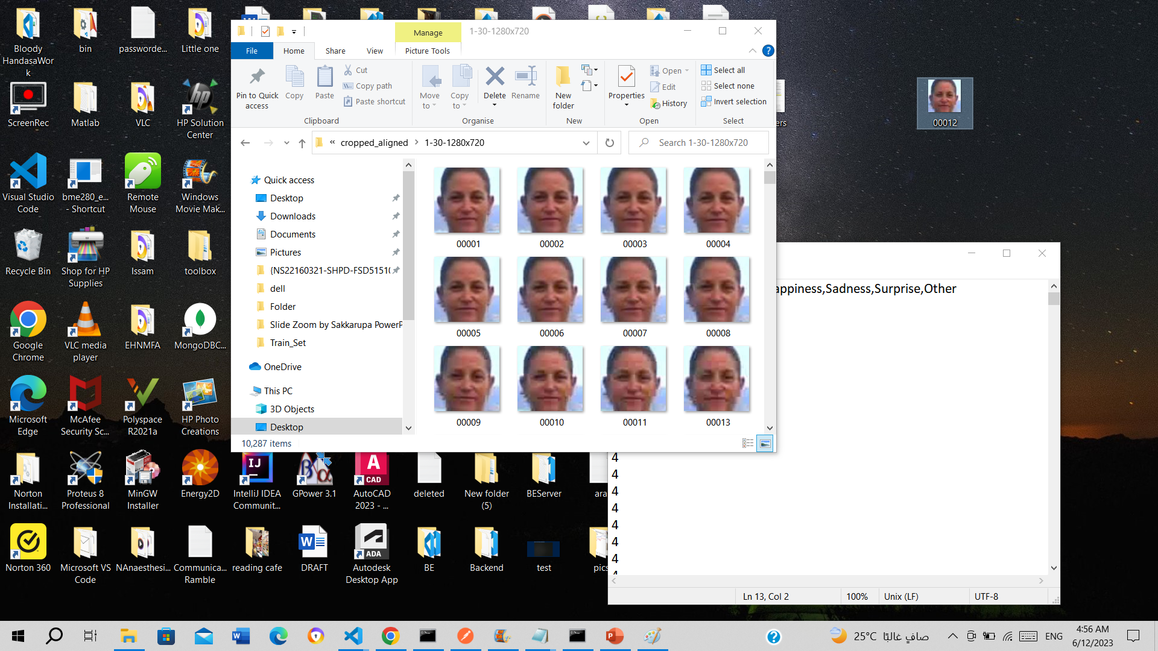
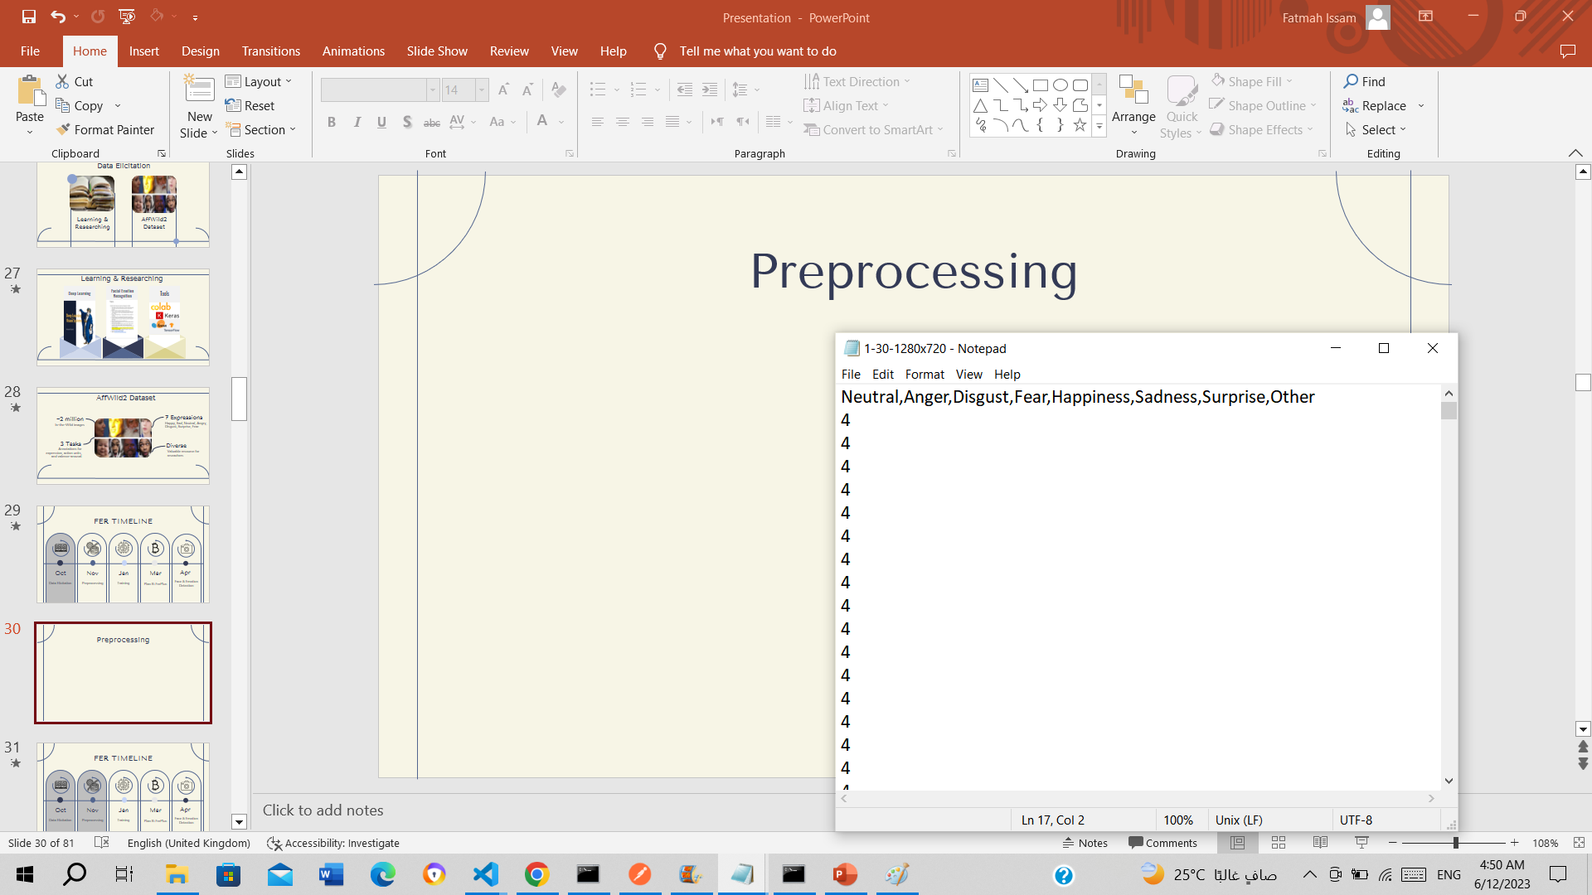

Preprocessing
00012.jpg

Slide 30
FER TIMELINE
Oct
Nov
Jan
Mar
Apr
Data Elicitation
Preprocessing
Training
Plan B: FerPlus
Face & Emotion Detection

Slide 31
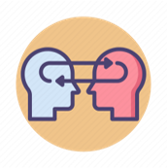


Conventional Approach
Pre-trained Approach
Training
Change

Slide 32
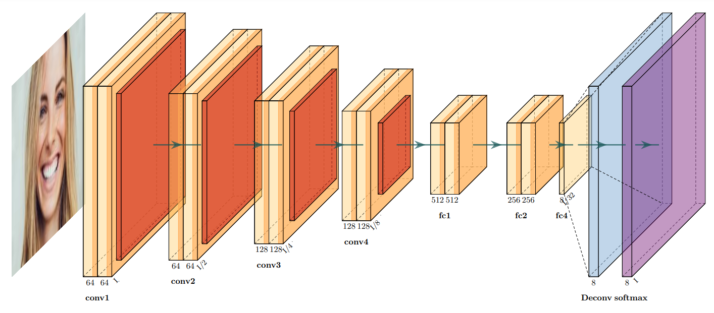
Conventional Approach: CNN

Slide 33
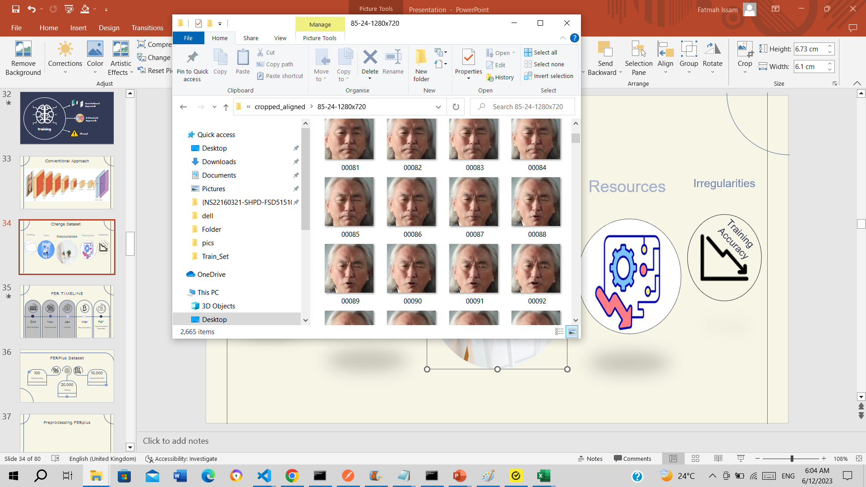
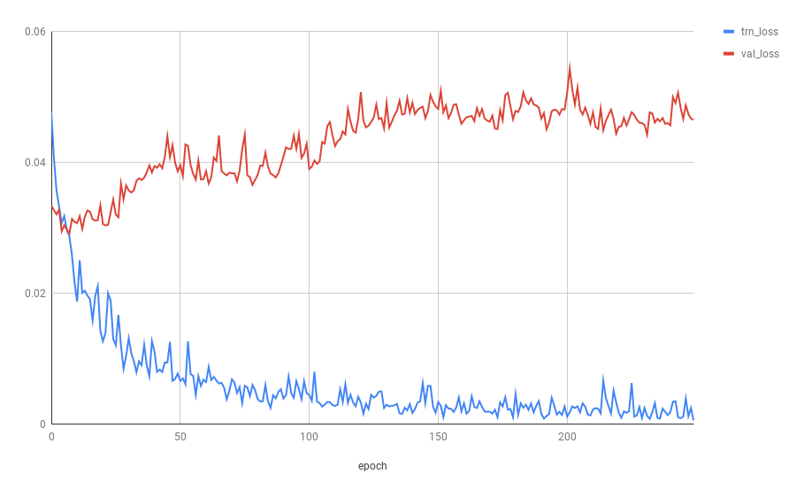



Change AffWild2 Dataset
Overfitting
Time
Inaccuracies
Resources
Irregularities
Training Accuracy

Slide 34
FER TIMELINE
Oct
Nov
Jan
Mar
Apr
Data Elicitation
Preprocessing
Training
Plan B: FerPlus
Face & Emotion Detection

Slide 35


FERPlus Dataset
Preprocessing
28558 training, 3579 validation, 3573 test
48x48 grayscale
Results
Best Model
Training
Conventional CNN
Transfer Learning

Slide 36
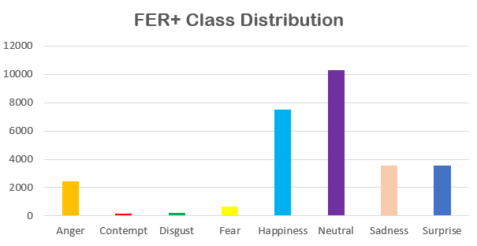
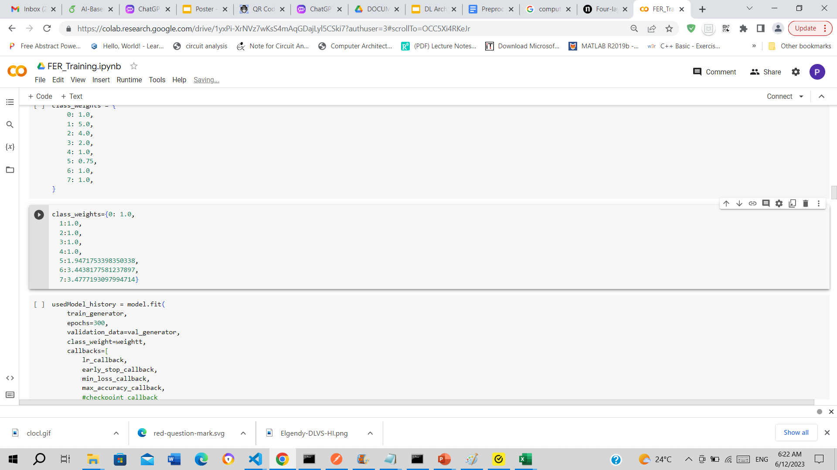
Training
Balanced by class weights during training
Learning Rate | 0.001 (Callback)
Optimizer | Adam
Loss Function | L = - sum(Y_true * log(Y_pred)
Pre-trained Models | ResNet50, MobileNetV2, EfficientNet

Slide 37
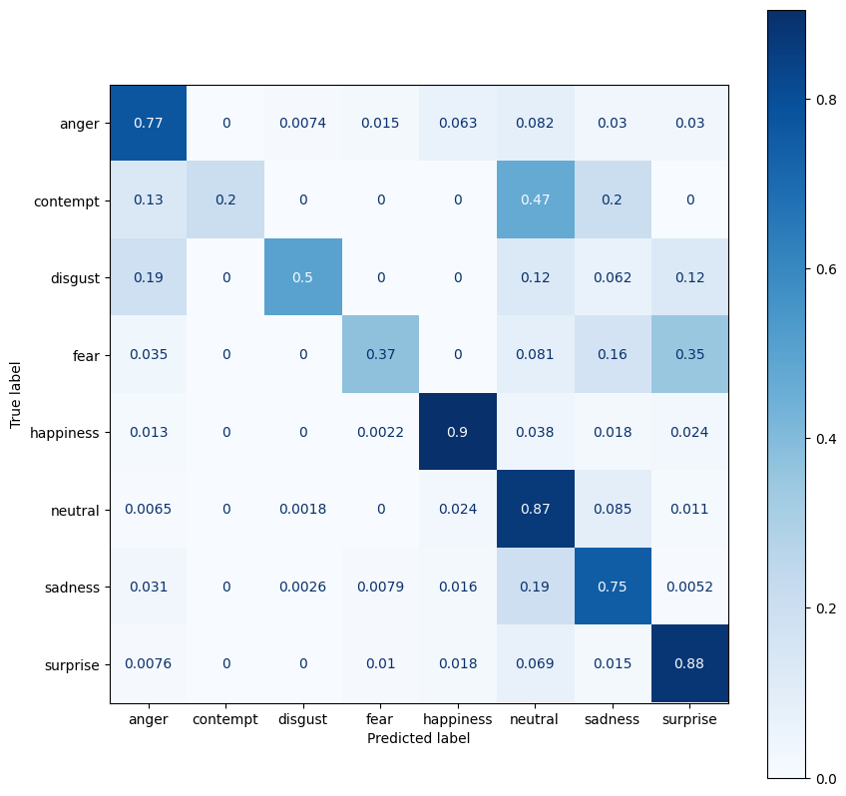
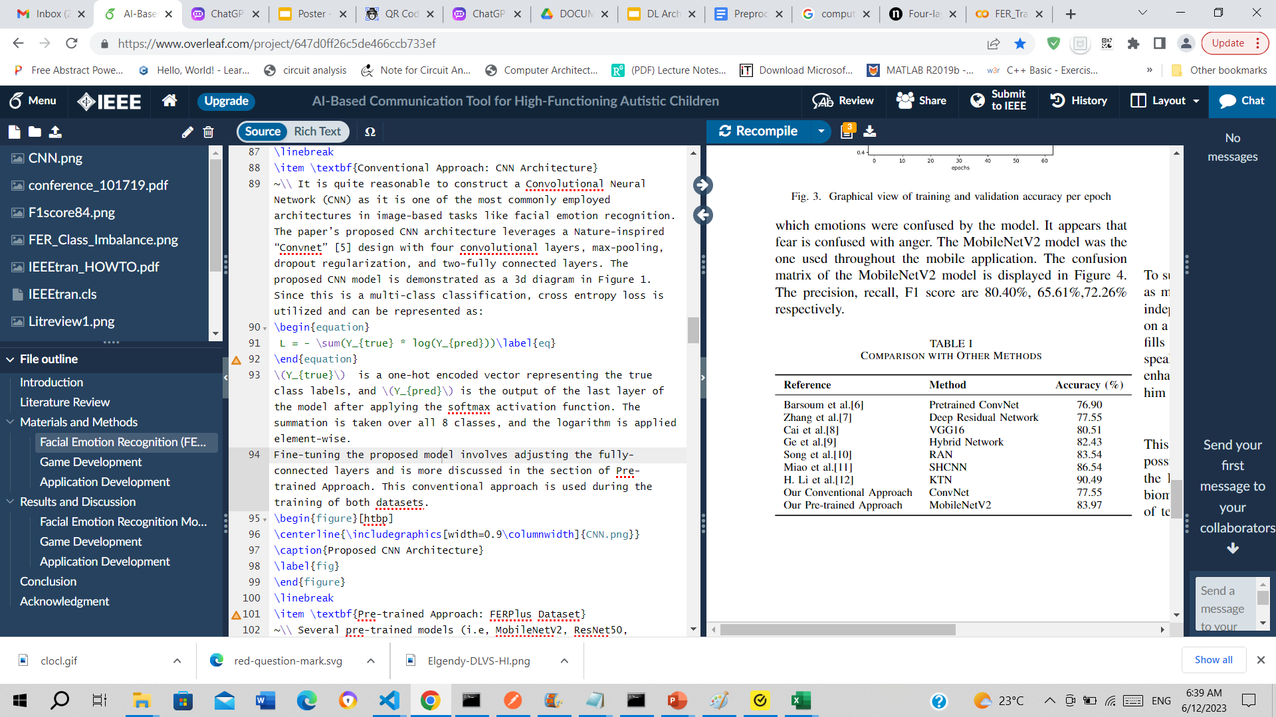
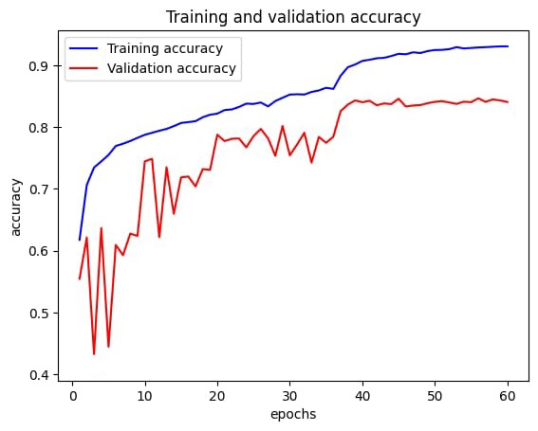
Results

Slide 38
FER TIMELINE
Oct
Nov
Jan
Mar
Apr
Data Elicitation
Preprocessing
Training
Plan B: FerPlus
Face & Emotion Detection

Slide 39
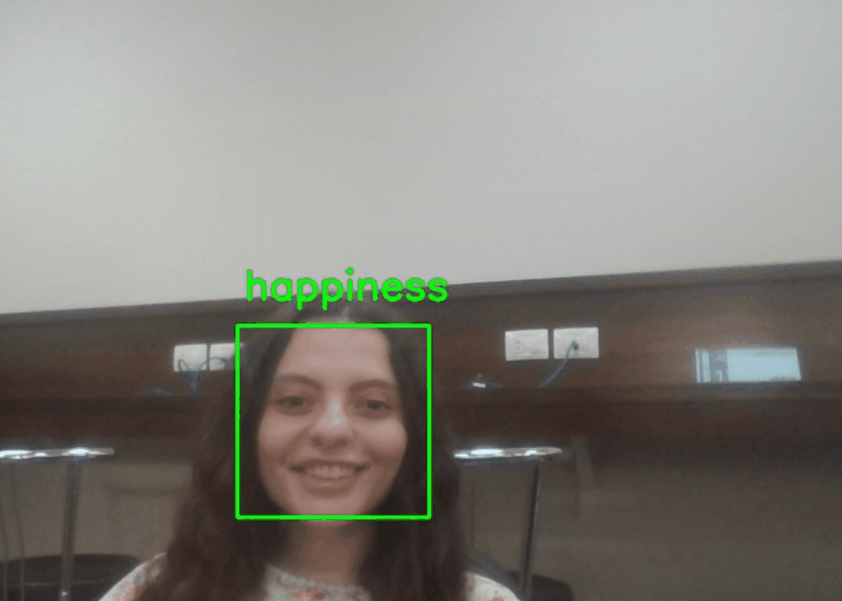
Detection

Slide 40
FER TIMELINE
Oct
Nov
Jan
Mar
Apr
Data Elicitation
Preprocessing
Training
Plan B: FerPlus
Face & Emotion Detection

Slide 41
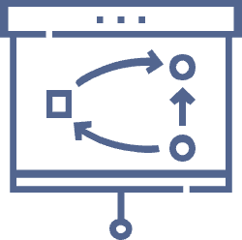
MOBILE APP TIMELINE
Oct/Nov
Nov/Dec
Dec/Mar
Apr/May
Design Phase
Learning Phase
Development Phase
Mobile Developement

Slide 42

Search for used therapies
Design games
Design Phase
Decide age group

Slide 43




Design games
Eight games were designed using “UIZard” and presented to specialists and three games were chosen

Slide 44

MOBILE APP TIMELINE
Oct/Nov
Nov/Dec
Dec/Mar
Apr/May
Design Phase
Learning Phase
Development Phase
Mobile Developement

Slide 45

Search different game engines
Unity Learn
Learning
Phase
Get familiar with unity

Slide 46
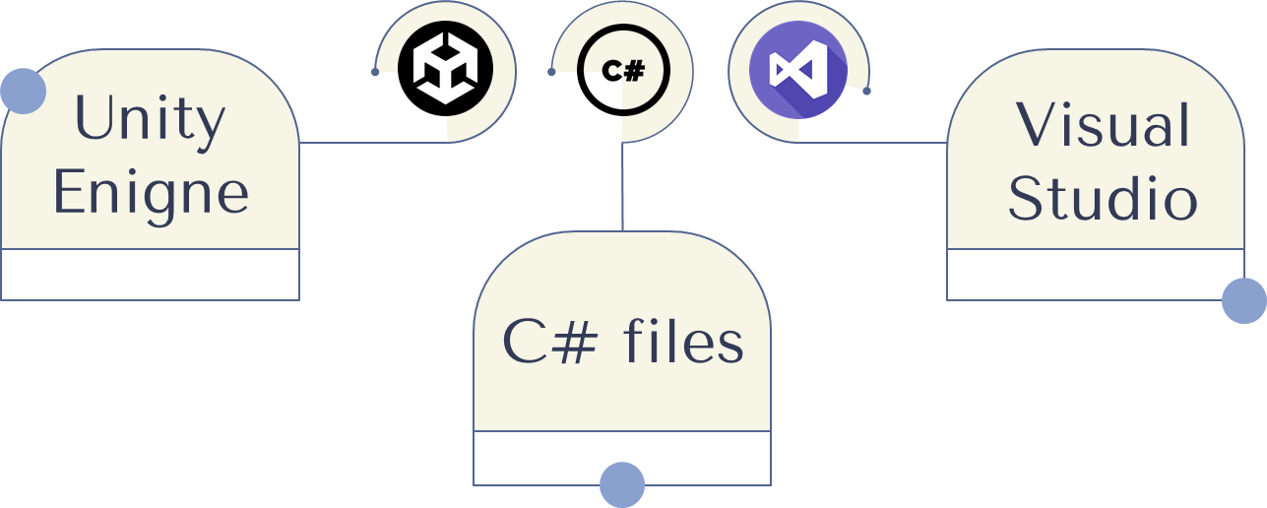
Unity learn

Slide 47

MOBILE APP TIMELINE
Oct/Nov
Nov/Dec
Dec/Mar
Apr/May
Design Phase
Learning Phase
Development Phase
Mobile Developement

Slide 48

Game 1 Development
Game 2 development
Development Phase
Game 3 development

Slide 49
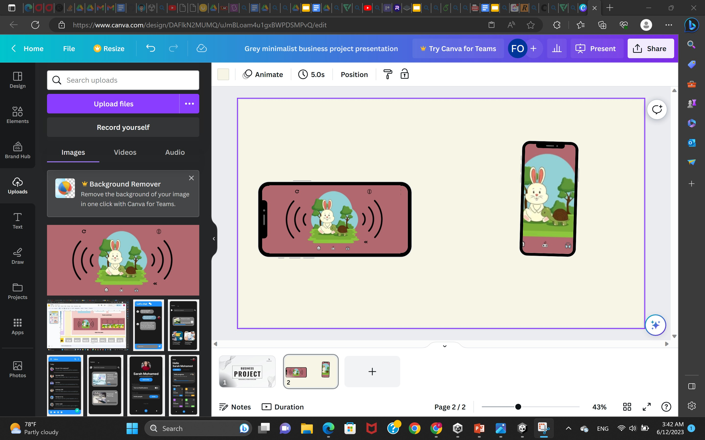
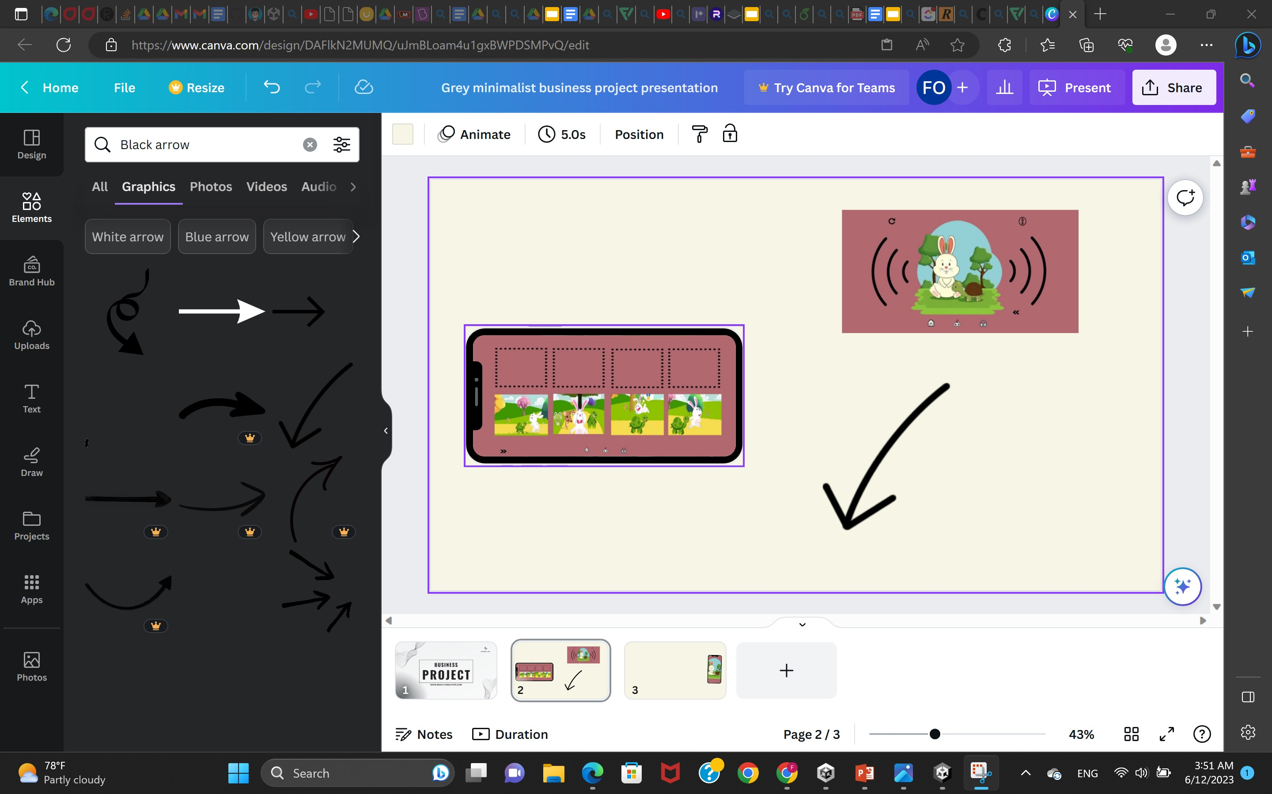
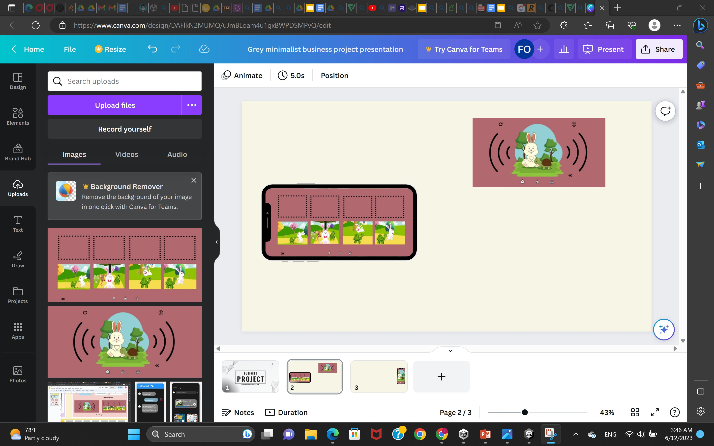
Audio Story

Slide 50
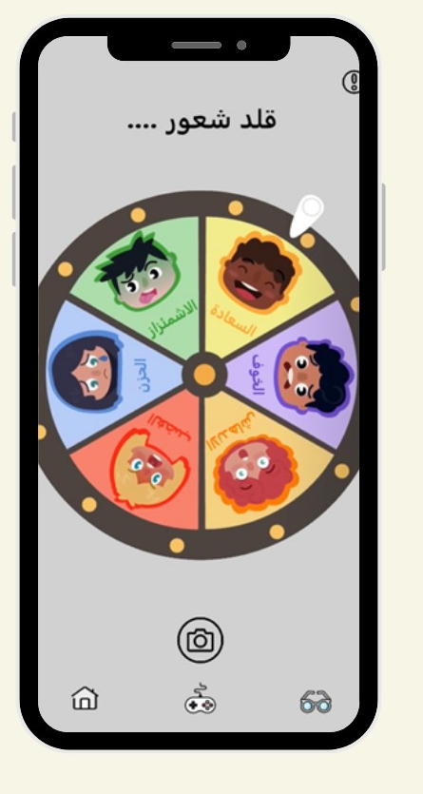
Wheel of emotions

Slide 51
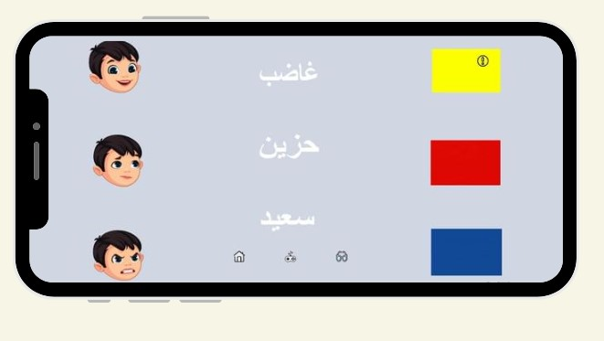
Match feeling with related objects

Slide 52

MOBILE APP TIMELINE
Oct/Nov
Nov/Dec
Dec/Mar
Apr/May
Design Phase
Learning Phase
Development Phase
Mobile Developement

Slide 53



Front end
Back end
Mobile Development
Testing & refinements

Slide 54
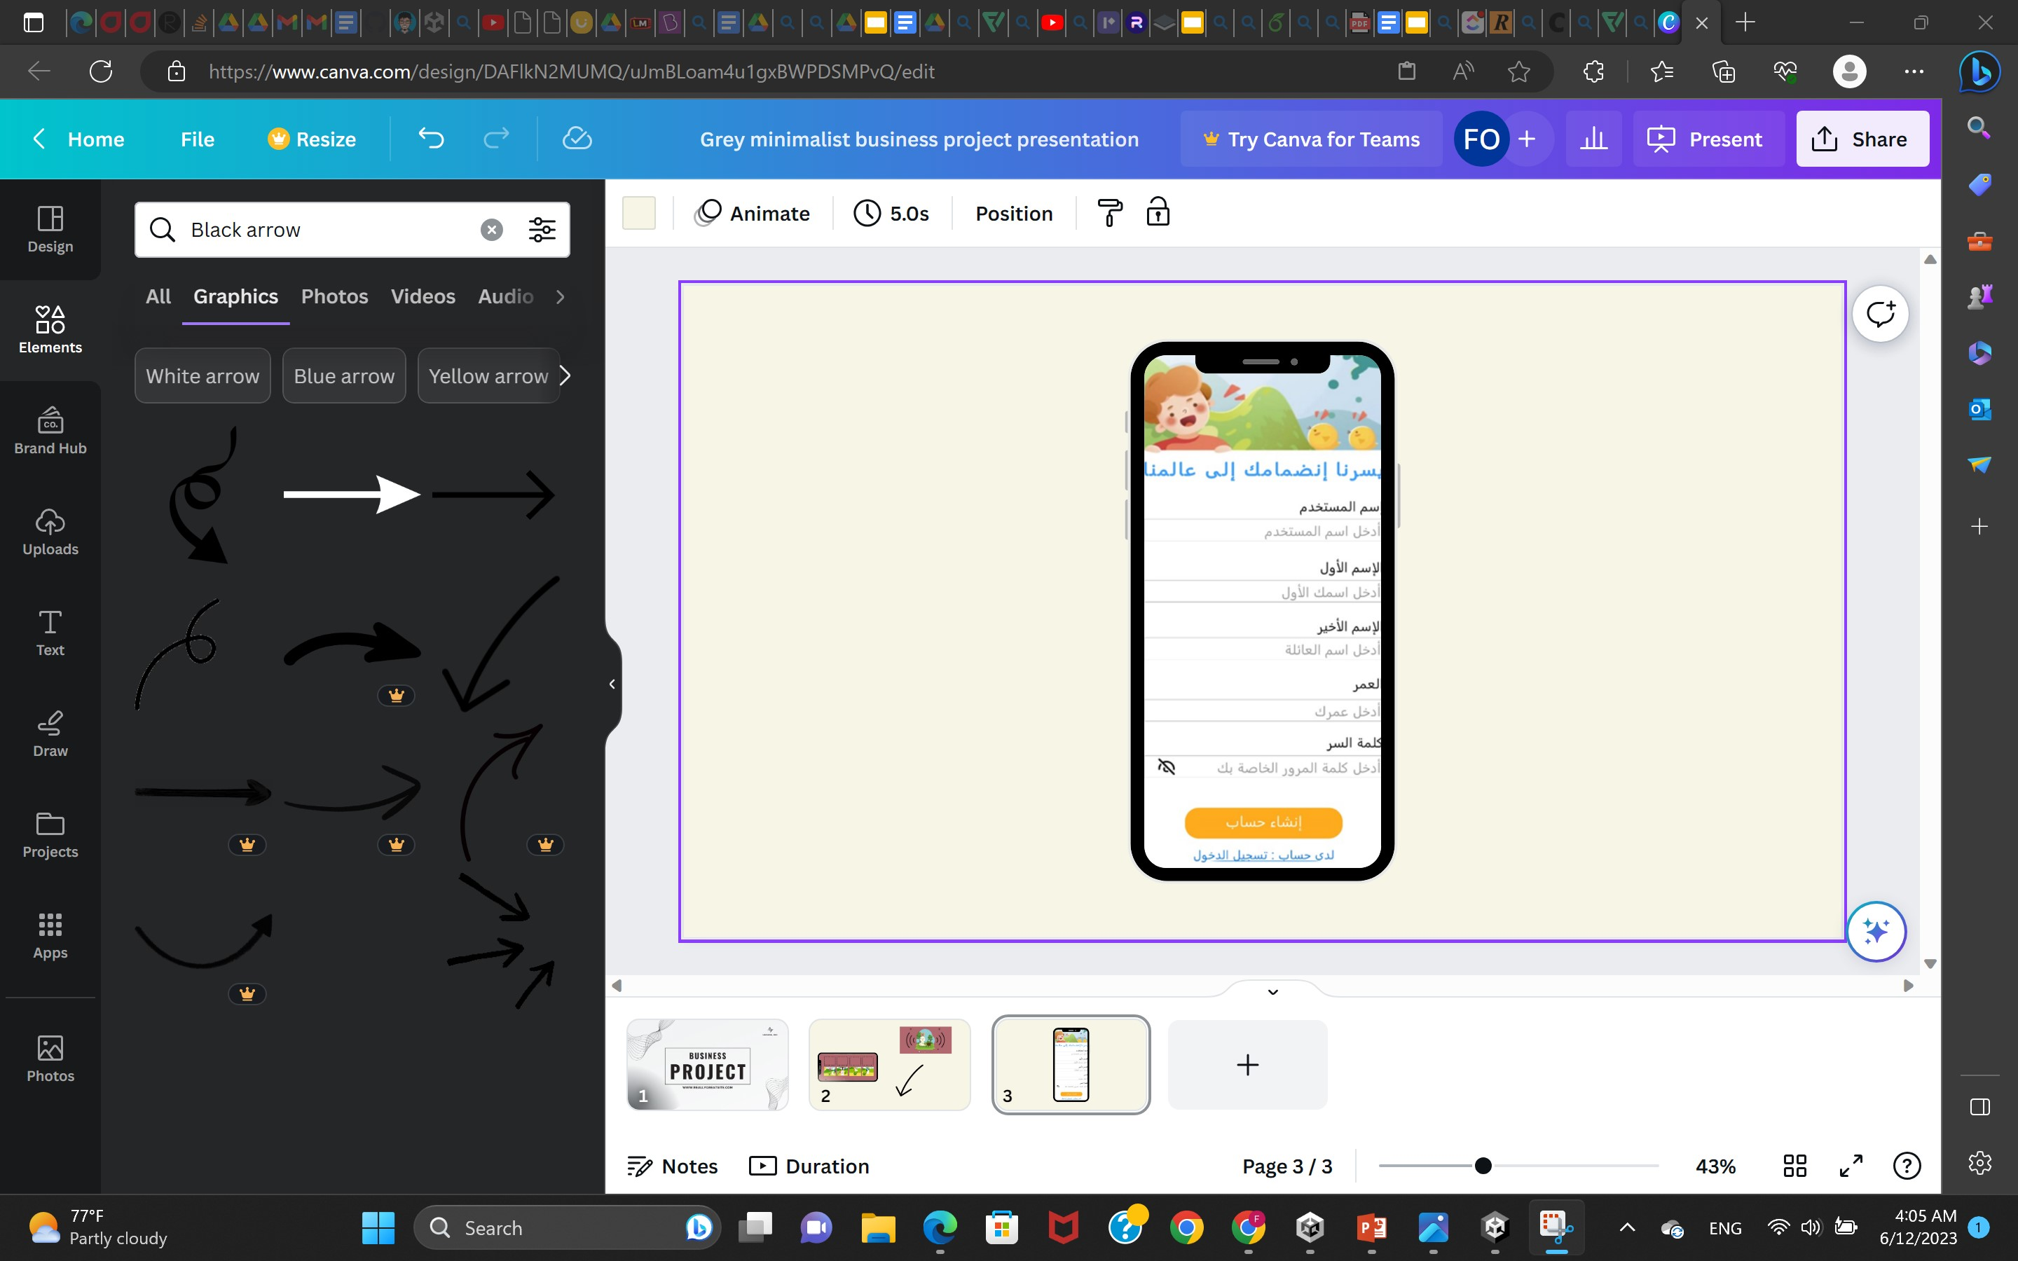
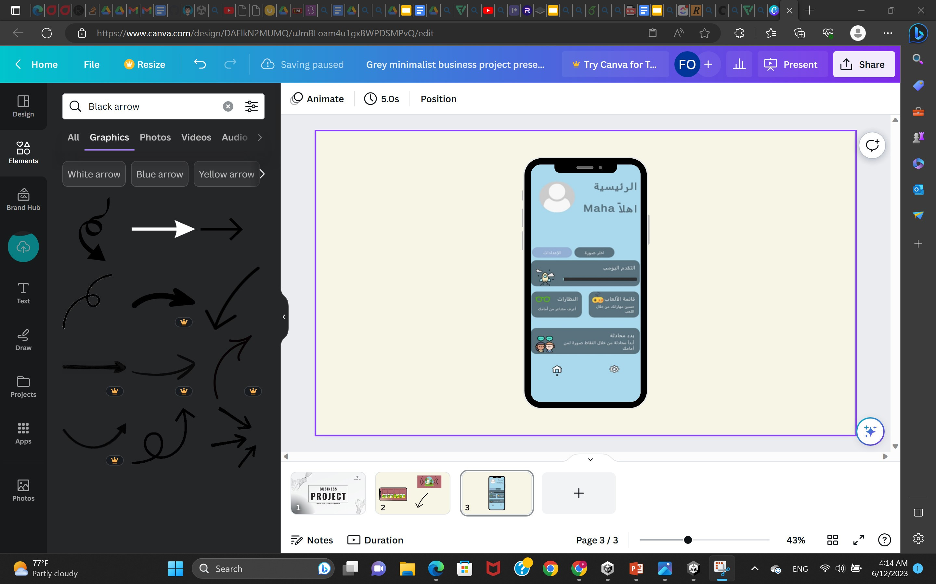

Front End

Slide 55
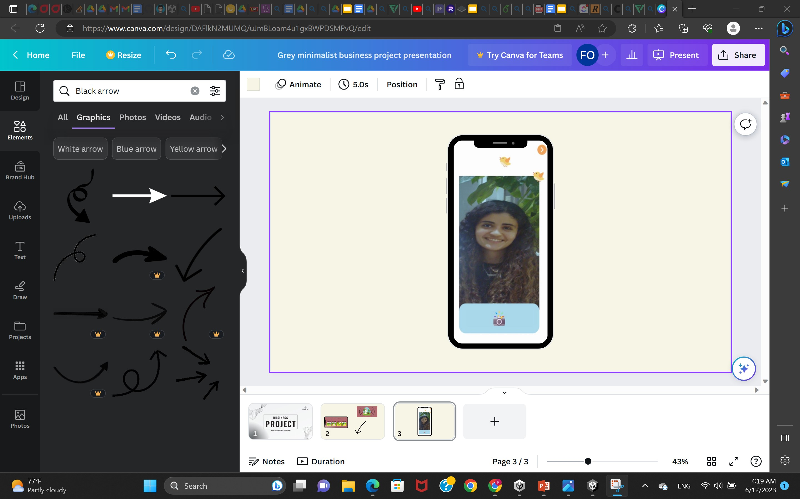
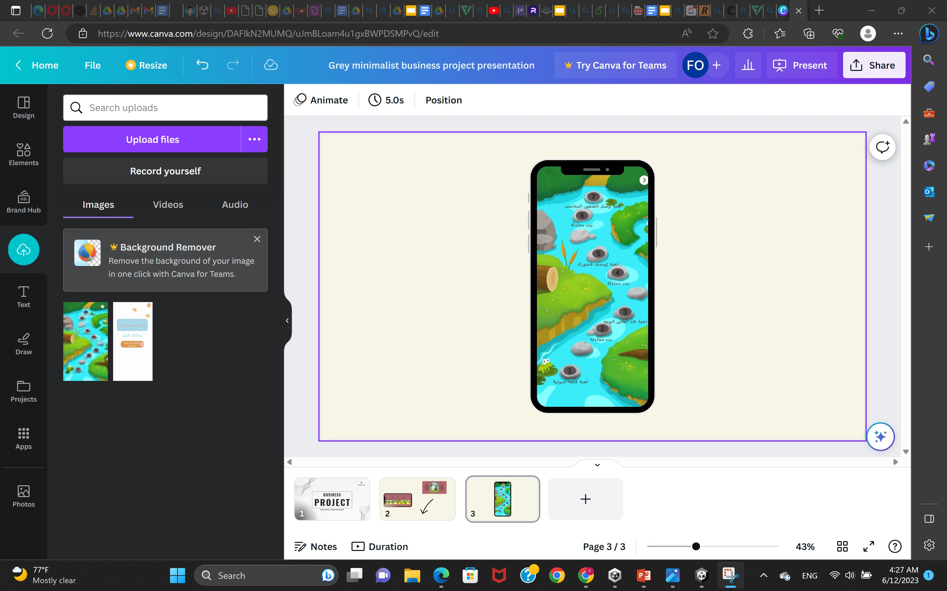
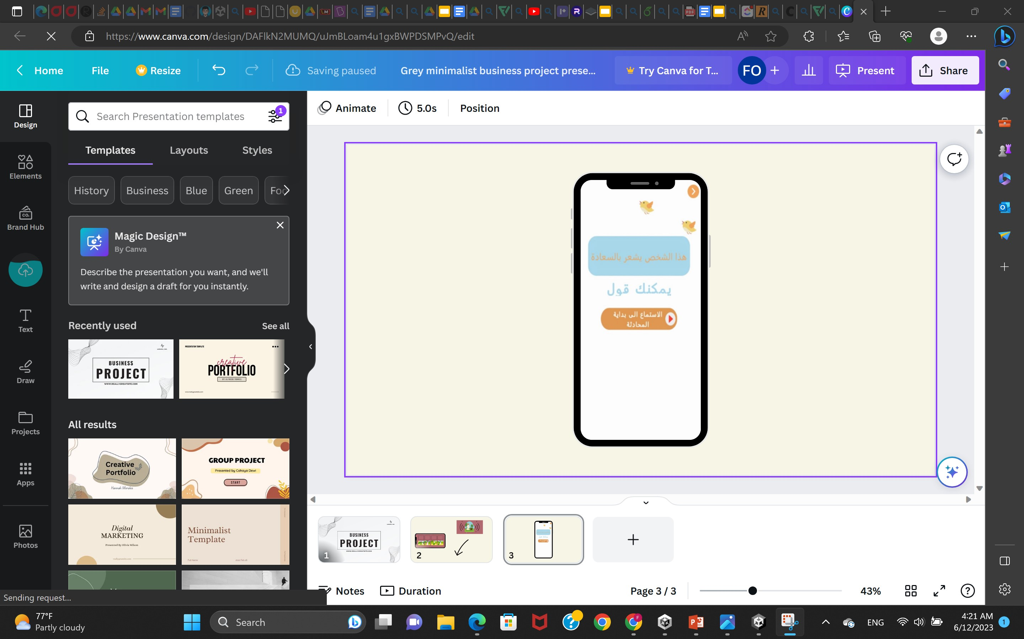
Front End

Slide 56



Back End (Technologies)
Flask framework
Deploying
Google Cloud Run
Database
SQLite

Slide 57
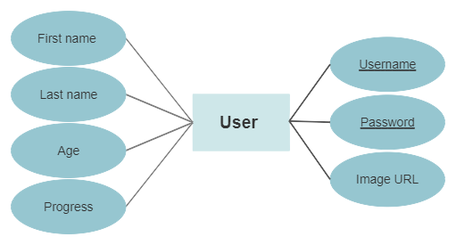
Easier sign-up
Primary key
Created a composite primary key between “username” and “password”, to avoid multiple trials.

Slide 58
Social Script
Text to speech
Speech to text
Similarity index
(not found)
Was made by customized voices
Google Speech recognition API.
Cosine similarity index
(>=0.5)

Slide 59
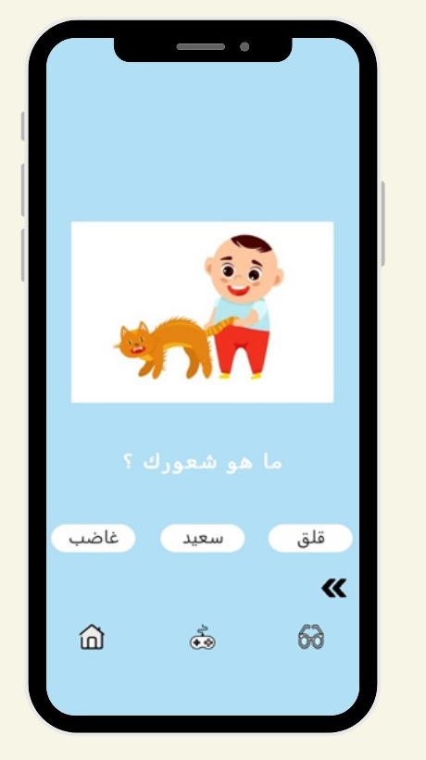
Testing & refinements
After the app was fully implemented,
we presented it to "Dr. Menan Abdelmaasod" and "Dr. walaa Hosny" and their feedback was taken into consideration.
"Dr. walaa Hosny" suggested that we add a fourth game from our previously designed games "What are you feeling?". According to the Dr's suggestion, The game was implemented and added to the mobile application.

Slide 60
MOBILE APP TIMELINE
Oct/Nov
Nov/Dec
Dec/Mar
Apr/May
Design Phase
Learning Phase
Development Phase
Mobile Developement

Slide 61
07
Conclusion
Future Work
Impact on Society

Slide 62
Future Work
Goal 1
Goal 2
Goal 3
Creating the proposed hardware.
Publishing the paper.
Constructing an API for text to speech in Egyptian dialect.

Slide 63
Impact on society
Less effort for doctors and caregivers
Decrease the frequency of the sessions.
The autistic child becomes less dependent.
The autistic child is more involved in society.

Slide 64
Refrences
Autism Speaks renews call for significant increase in funding for research and services to support the 2.3% of U.S. children with autism spectrum disorder (prnewswire.com)
Autism Statistics & Facts: How Many People Have Autism? (thetreetop.com)
About Autism - The Autism Community in Action (tacanow.org)
D. Kollias: ” ABAW: Learning from Synthetic Data & Multi-Task Learning Challenges ”, 2022
FERPlus. Kaggle. https://www.kaggle.com/datasets/ss1033741293/ferplus
Debnath, T. et al. (2022) Four-layer ConvNet to facial emotion recogni- tion with minimal epochs and the significance of data diversity, Nature News.https://www.nature.com/articles/s41598-022-11173-0
Barsoum, E., Zhang, C., Canton Ferrer, C., & Zhang, Z. (2016). ”Training deep networks for facial expression recognition with crowd-

Slide 65
THANKS
Do you have any questions?

